Slide 1

RATION VENDING MACHINE
VIDYA VIKAS INSTITUTE OF ENGINEERING AND TECHNOLOGY
#127-128, Mysuru-Bannur Road, Alanahally Post, Mysuru-570028
Presented By:
U Prajwal 5th Sem ISE, VVIET
Bhoopathi Raj C 5th Sem ISE, VVIET
Jayanth N 5th Sem ISE, VVIET
Vishal N V 5th Sem ISE, VVIET
Abhay Kumar M D 5th Sem ISE, VVIET
Shreevathsa B N 5th Sem ISE, VVIET
Manoj Gowda N S 5th Sem ISE, VVIET

Slide 2
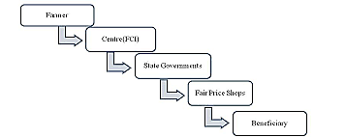
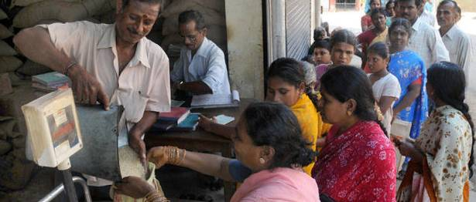
RATION VENDING MACHINE
1. Introduction
The Traditional Public Distribution System(TPDS) was introduced in the year 1997 to benefit the poor and keep the budgetary food subsidies under the control of the Government at the desired extent.
TPDS is aimed at reducing poverty through delivering minimum requirements of food grains at highly subsidized prices.
The stocks for these ration shops will be bought directly from the farmers and then sold at subsidized rates.

Slide 3

RATION VENDING MACHINE
2. Problem Statement
The Traditional Public Distribution System(TPDS) has drawbacks which involve lot of corruption such as black marketing of these food grains and many families claim the quota of other families.
Even when the material is not bought at the end of the month, the shopkeeper would send them to others without permission of the Government.
There is no transparency between the Government and the customer.

Slide 4
RATION VENDING MACHINE
3. Objectives
This system helps in reducing the corruption/ black marketing of food grains.
This system allows user to buy grains at any time.
Consumers can obtain the grain at subsidized rates set by the government.
To reduce the overall time of the transaction of grains.

Slide 5
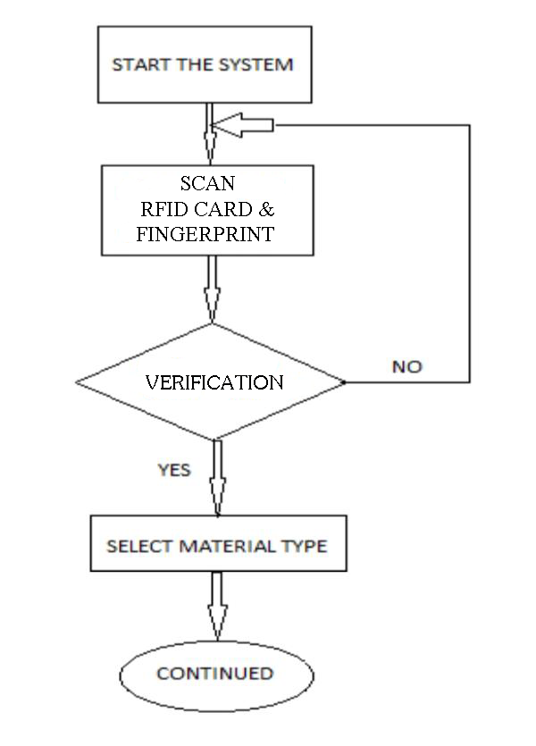
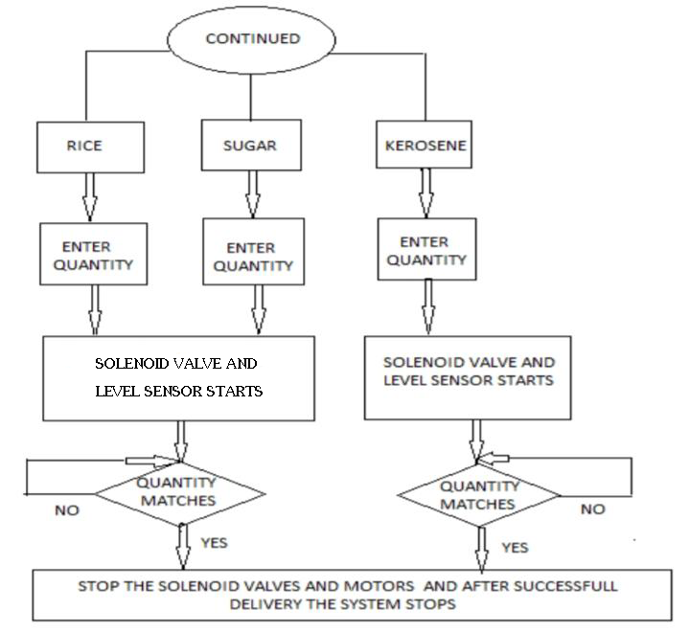
RATION VENDING MACHINE
4. Methodology

Slide 6
RATION VENDING MACHINE
4. Methodology
Power Supply
Fingerprint Module
RFID Reader
4 4
Raspberry Pi 4
Keypad
GUI Screen
Sugar Tank
GSM Module
Rice Tank
Solenoid Valve
Solenoid Valve

Slide 7
RATION VENDING MACHINE
5. Budget
For the proof of concept, the estimated cost is Rs 85,000.
For the project preparation, the estimated cost is Rs 1,26,000.
For the report preparation, the estimated cost is Rs 4,000.
The total amount estimated for the project is Rs 2,15,000.

Slide 8
RATION VENDING MACHINE
6. Conclusion
This system has a greater scope in the future involving automated product delivery or even online transaction.
In this system, the ration is distributed by an automated mechanism without any human intervention.

